Slide 1


WELCOME TO D213
Advanced Data Analytics - Task 2
Disclaimer
This PowerPoint is not an official WGU resource. It is my rough note for the Cohort Webinar. Not intended for publication. It is a work in progress and intended for the students who have asked for it in the form it is. Any questions should be directed to:
Dr. Festus Elleh
festus.elleh@wgu.edu
385-428-3501
Thank you.

Slide 2
Welcome Message
Welcome to D213 – Advance Data Analytics! We are glad you are here. D213 is your penultimate course putting you one step closer to graduation. On starting the course, follow the study plan below:
Download and review the “One Page Course Overview” from the Course Chatter.
Aim to complete the course in 2-4 weeks.
Review the two tasks to determine a roadmap for the course.
Select your data set.
Determine the appropriate tool for the task (Python or R).
In Task 1, apply the ARIMA model to implement Time Series Analysis
In Task 2, identify a type of Neural Network (RNN, CNN, DNN, etc.) for your analysis.
In Task 2, apply the NLP technique and TensorFlow for your analysis.
Review DataCamp videos relevant to your programming language.
Visit the programming center for programming support and email programmingcenter@wgu.edu if you have any questions.
Attend the Cohort Webinar that holds on the 3rd Sunday of every month. Time
https://srm.my.salesforce.com/apex/CohortLiveEvent?id=a2w3x00000917k7
Schedule a time with your Course Instructor if you have any questions.
We wish you success and a great learning experience!

Slide 3


Task 2: Sentiment Analysis: Neural Network (NN) Natural Language Processing (NLP)

Slide 4
Excellence Award
This is what an excellent paper looks like:
“The submission presents a detailed analysis and implementation of a sentiment analysis to analyze product reviews. The work provides a methodological explanation of the stages of the analytical process, justification of actions, visualization elements, and on-point interpretation of the results. The assessment successfully demonstrates competencies in the implementation of complicated data preprocessing techniques and ideas behind the successful implementation of deep learning architectures.”

Slide 5
DataCamp Resources
Instructor Resources
Task 2 R Resources
Introduction to Natural Language Processing in R
Text Mining with Bag-of-Words in R
Sentiment Analysis in R
D213 Videos – Dr. Elleh
D213 Installing TensorFlow in Python and R
D213 Preparing Python and R Environments
D213 T2 Building NN Model in Python
D213 T2 Data Preprocessing in Python
D213 Task 2 Cohort Webinar PPT.pptx
D213 Videos - Dr. Sewell:
D213 Webinar 4 recording: D213 Webinar 4 Video and the accompanying D213 Webinar 4 PPT.
D213 Webinar 5 recording: D213 Webinar 5 SA and the accompanying D213 SA Webinar 5.pptx
D213 Webinar 6 recording: D213 Webinar 6 SA and the accompanying[WS1] D213 Webinar 6 PPT
Python Resources
Introduction to Deep Learning in Python
Introduction to TensorFlow in Python
Natural Language Generation in Python
Data Scientist and contributor to Keras and TesnorFlow libraries
Building Chatbots in Python

Slide 6
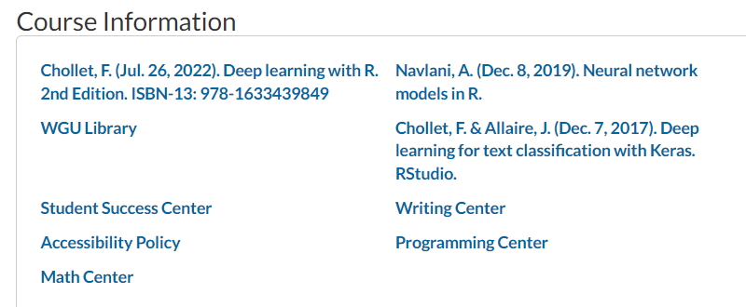
Other Learning Resources on the HomePage
Dataset
UCI Sentiment Labeled Sentences Data Set.
Amazon_cells_labelled.text
Imdb_labelled.text
Yelp_labelled.txt

Slide 7

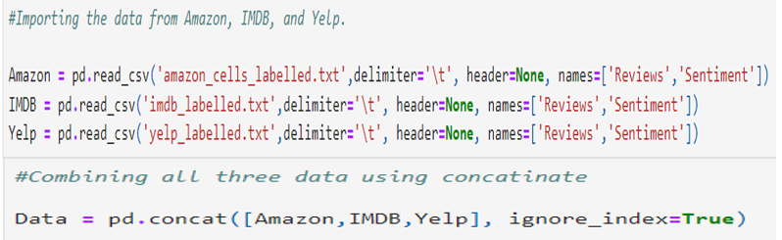

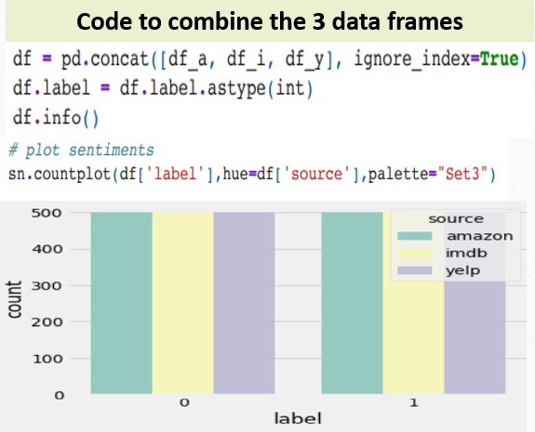

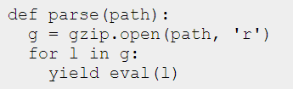
Importing Data
Another Example
A simple script to read json-formatted data:

Slide 8
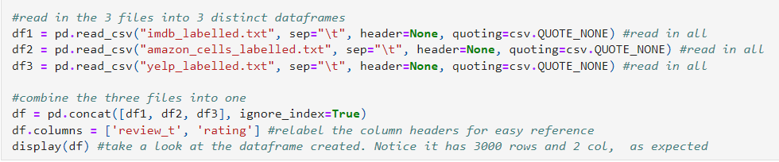
Further examples in Import and reading in UCI Text Files.
First determine the path to your directory:
ellehPath = "C:\\Users\\babyr\\Desktop\\Data Analytics\\D213 Advanced Analytics\\Task 2 Files\\" os.chdir(ellehPath)
https://stackoverflow.com/questions/33565199/how-to-append-multiple-files-in-r

Slide 9
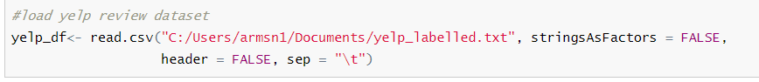
Code in R to import, reading, and concatenate UCI Text Files.
reviews <-read.csv("beer_reviews.csv", stringsAsFactors = FALSE)
#load yelp review dataset
yelp_df<- read.csv("C:/Users/armsn1/Documents/yelp_labelled.txt", stringsAsFactors = FALSE,
header = FALSE, sep = "\t")
Can use the rbind() and the cbind() functions to combine two data frames together in R.
rbind() - combines two data frames vertically.
cbind() - combines two data frames horizontally.

Slide 10
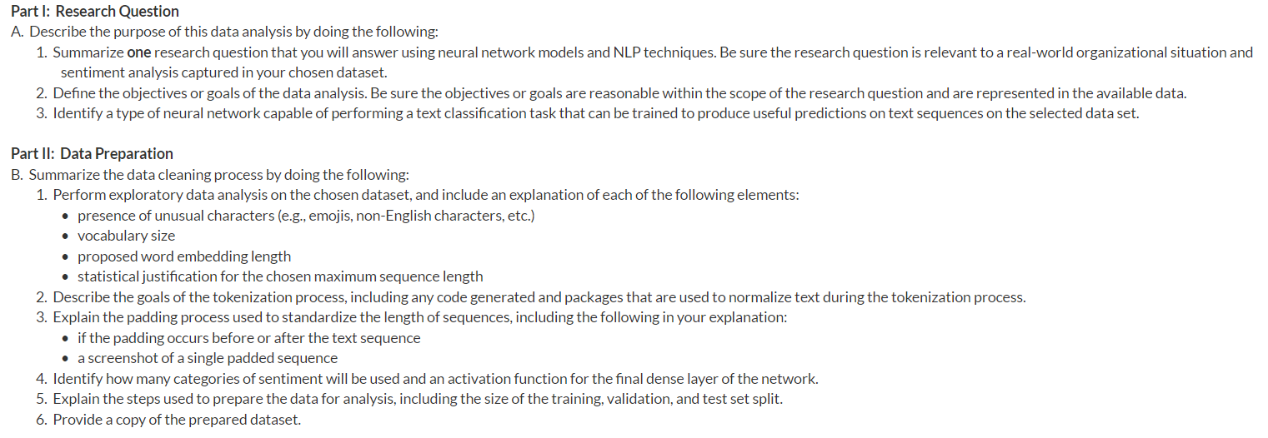
REQUIREMENTS

Slide 11
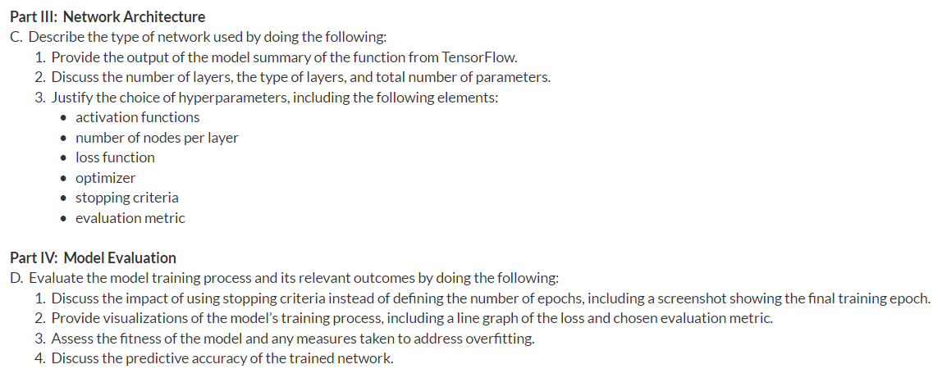

Slide 12
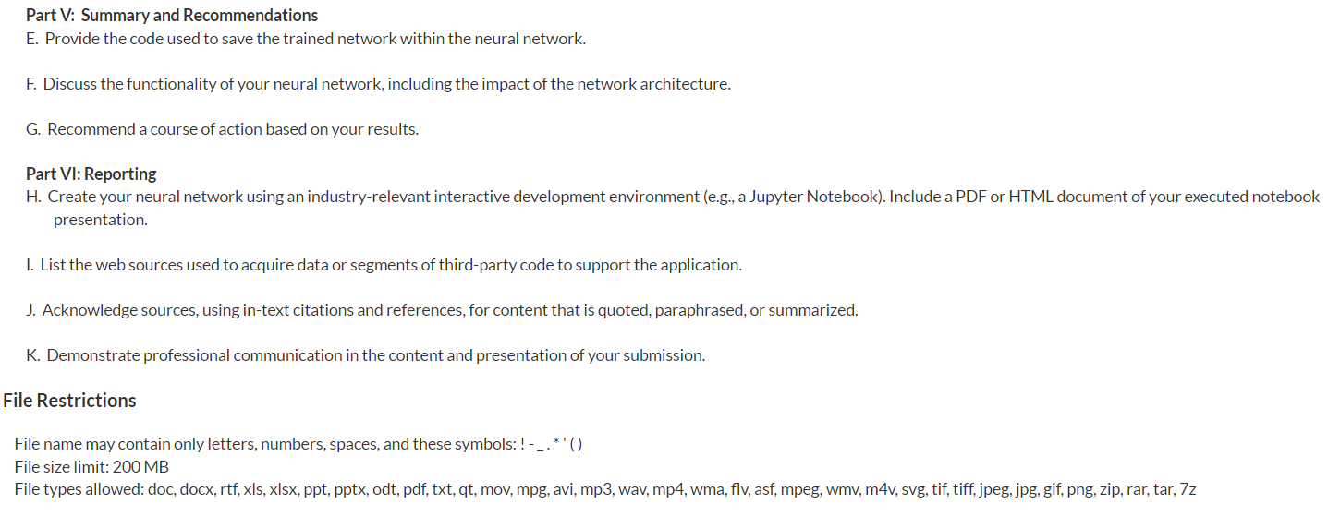

Slide 13
Research Question: Samples
Part I: Research Question
A. Describe the purpose of this data analysis by doing the following:
1. Summarize one research question that you will answer using neural network models and NLP techniques. Be sure the research question is relevant to a real-world organizational situation and sentiment analysis captured in your chosen dataset.
Ex 1. Can we predict a user’s opinion on a product or service as either positive or negative, using previous reviews from other users?
Ex 2. What effect will Natural Language Processing and Neural Networks have on the ability to predict future consumer sentiment?
Ex 3. Is it possible to analyze customer sentiment using neural networks and the NLP technique so that company can take appropriate actions to improve customer satisfaction?
Ex 4. What are the Top 10 words combination used to express sentiments.

Slide 14
Aligning Research Question with the Outcome of the Analysis Example
Example Research Question:
Is it possible to analyze customers’ sentiments from the reviews using neural networks and the NLP technique so that company can take appropriate actions to address any concerns from the reviews?
Outcome or Result of the Analysis
The trained neural network is capable of processing natural language to identify sentiments from customer reviews. The neural network has great predictive accuracy and is therefore capable of analyzing customer feedback and identifying sentiments in the review texts submitted by customers. This sentiment analysis can help the company to figure out which products are liked or not liked by customers based on the positive and negative reviews. Based on this analysis, the company can take appropriate action to address any concerns shown in the reviews.

Slide 15
Goal: Samples
A2. Define the objectives or goals of the data analysis. Be sure the objectives or goals are reasonable within the scope of the research question and are represented in the available data.
Ex 1. The goal of this data analysis is to attempt to predict how a user feels about a product or
service based off the word choices that the user has chosen.
Ex 2. The goal is to find out how the sentiments of customers differ based on the reviews from IMDB, Amazon, and Yelp.

Slide 16
A3. Identify a type of neural network capable of performing a text classification task that can be trained to produce useful predictions on text sequences on the selected data set.
Neural Network is a series of algorithms that endeavor to recognize underlying relationships in a set of data through a process that mimics the way the human brain operates. In this sense, neural networks refer to systems of neurons, either organic or artificial in nature. NN and NLP techniques can be used to analyze product reviews submitted by the customers and identify positive and negative sentiments from those reviews.
Ex 1. Recurrent Neural Networks (RNN) RNN works with sequential data, but the traditional NN cannot. RNN is used for sentiment analysis and text classification including Sequence labeling, Speech, tagging, etc.
RNN has 1 Layer with inputs and outputs to that one layer. It remembers each piece of information through time. It is useful in time series prediction only because of the feature to remember previous inputs as well. Recurrent neural networks are even used with convolutional layers to extend the effective pixel neighborhood. RNN is difficult to train, and because it uses backpropagation, it has the problem of vanishing gradient.
https://www.youtube.com/watch?v=_aCuOwF1ZjU
https://www.youtube.com/watch?v=C0xoB8L8ms0

Slide 17
A3. Cont’d
Ex 2: Deep Neural Network (DNN) – The Vanilla Deep Learning NN is a type of neural network capable of performing text classification and identifying customer sentiments. DNN is a type of recurrent neural network (RNN) that works best on sequential data. Sequential data is one in which the points in a dataset are dependent on the other points e.g. time series data, stock prices, and gene sequences.
Ex 3: Artificial neural network (ANN) has an input layer, multiple hidden layers, and one output layer. The model will be created by implementing an Embedding layer before introducing multiple hidden Dense layers.

Slide 18
Ex 4. Convolutional Neural Networks (CNN) is a class of artificial neural networks, most applied to analyze visual imagery.
The main difference between a CNN and an RNN is the ability to process temporal information — data that comes in sequences, such as a sentence. Recurrent neural networks are designed for this purpose, while convolutional neural networks are incapable of effectively interpreting temporal information.
Long Short-Term Memory (LSTM) is a special kind of RNN, capable of learning long-term dependencies, which other neural networks struggle with (Olah, 2015). It is a specific neural network that can be trained for text sequential on our dataset. LSTM can be slow-trained and can be trained on GPU hardware.
Generative Adversarial Networks (GANS) - developed by Ian Goodfellow for Generative AI images. Create new data instances that resemble your training data. For example, GANs can create images that look like photographs of human faces, even though the faces don't belong to any real person. https://www.projectpro.io/article/generative-adversarial-networks-gan-based-projects-to-work-on/530

Slide 19
Natural Language Processing (NLP)
Is the use of a computer technology to manipulate human language like texts, e-mails, speech, and communicating across languages. Examples are POS tagging, email filters, smart assistants, search engines. To properly understand NLP, you might want to review literature on the following topics.
Language Models
Bag of Words & N-grams
Grammar & Augmented Grammars
Parsing
Real Natural Language
Natural Language Tasks

Slide 20

Python |  | R
Libraries/Packages | Uses | Libraries/Packages | Uses
pandas | Dataframe and data manipulations | Ggplot2 | Data visualization
numpy | Provides array objects for calculations | tidytext | Enable text mining functions
matplotlib | Data visualization | stringi | Search strings for non-ASCII characters
sns | Color palette vlag | stringr | Split strings for text manipulation
seaborn | Visualization like data distribution matrix | corpus | Segment text into tokens and stem words
nltk | Natural Language Toolkit | purr | Enhances R's functional programming (FP) toolkit
re | Regular expression usage | lubridate | For statistical computing
gzip | Unzipping the input customer review files | stopwords | Identifies the stopwords
warnings | Ignore warning | qdap | Parsing tools for transcript data and quantitative discourse analysis.
Sklearn or scikit-learn | Splitting the data, one-hot encoding, regression, classification, and statistical ML | SnowballC | API to the C 'libstemmer' library that implements Porter's word stemming algorithm
Tensorflow from Google | Neural network API | tensorflow
keras | Data preprocessing | keras | Neural Networks 'API
statsmodels | Api for statistical models | rmarkdown | Converts R Markdown docs into different formats
os | View Operating system file information | tokenizers | Convert natural language into tokens
joblib | Save and load the model | tm | For text mining
Pytorch from FB | computer vision and natural language processing | visdat | Provides visualizations of an entire data frame
spacy | NLP
Opencv | Image processing

Slide 21
Part II - Data Preparation: Summary Steps
Data Preparation Summary Steps
Import data set as a data frame.
Load packages for TensorFlow, Keras, and other libraries.
Remove null and nan
Remove unusual characters: uppercase letters, punctuation marks, emoticons, and non-English characters.
Measure the vocabulary size using (bags of words, etc.).
Explore N-Gram (unigram, bigram, and trigram) structures for usefulness in text analysis as applicable.
Determine the word embedding and explore embedded words based on target inputs.
Set the maximum sequence length based on the length of the longest sentence in the data set.
Tokenize sentences into a list of tokens and remove stop words.
Pad cleaned sentences to fit the maximum sequence length after each text sequence.
Create an activation function filled with dense layers of the neural network.
Split the data set into training and test sets or into training/test/validation sets.

Slide 22
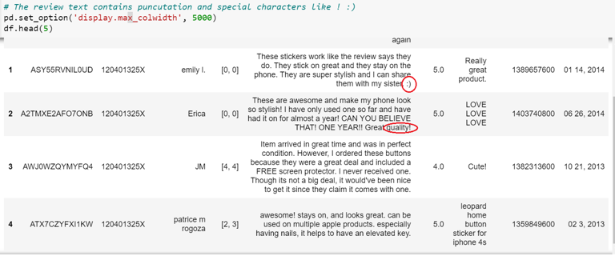
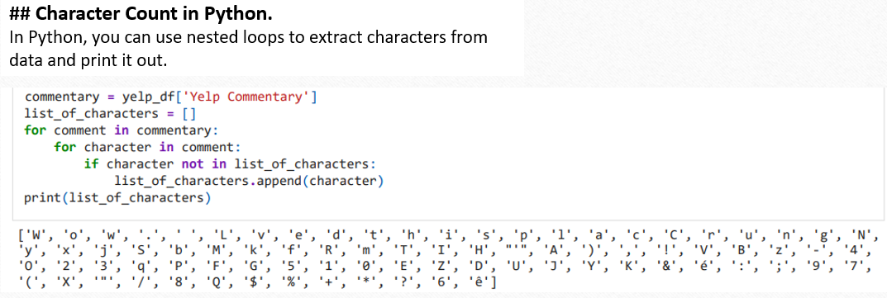
Part II: Data Preparation
B. Summarize the data cleaning process by doing the following:
1. Perform exploratory data analysis on the chosen dataset, and include an explanation of each of the following elements:
• presence of unusual characters (e.g., emojis, non-English characters, etc.)
• vocabulary size
• proposed word embedding length
• statistical justification for the chosen maximum sequence length.
B1a. Presence of unusual characters (e.g., emojis, non-English characters, etc.). Your EDA should show the special characters in the review ! , emojis, like :). Below are two alternative Python codes to show special characters:

Slide 23
A Python code to remove stop words, special characters, etc.:
description_list = []
stop_words = stopwords.words('english')
for description in review_df.review:
Example 1: Removing unusual characters
#Regular Expression can remove special characters from the string. It will be in the form [^a-zA-Z0-9], where ^ represents any character except the characters in the brackets, and a-zA-Z0-9 represents that string can only have small and capital alphabets and numerical digits.
description = re.sub("[^a-zA-Z]", " ", description)
#Convert to lower case
description = description.lower()
#Perform tokenization
description=nltk.word_tokenize(description)
#Perform lemmatization
lemma = nltk.WordNetLemmatizer()
description = [lemma.lemmatize(word) for word in description]
#Removing stopwords
description = [word for word in description if not word in stop_words]
description = " ".join(description)
description_list.append(description)
description_list = []
stop_words = stopwords
Alternatively:
df = getDF('reviews_Cell_Phones_and_Accessories_5.json.gz’)
Disallowed_characters = “?, !, :, #, “
For character in disallowed_characters:
review_df.review = df.replace(character, “ “)
print(review_df.review )

Slide 24
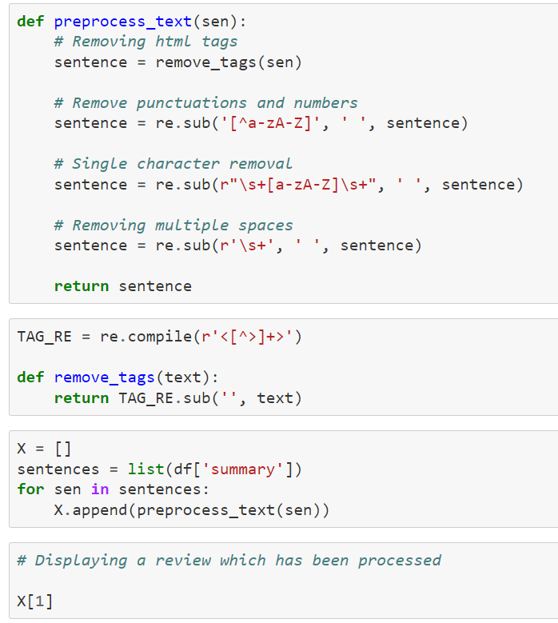
Example 2: Removing unusual characters
Processing the string to remove punctuations and any HTML tags.

Slide 25
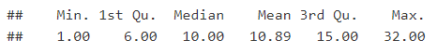
## Character/Word Count in R.
In R, you can use a nested loop statement to extract characters and print out the list of characters.
yelp$review %>% strsplit(" ") %>% sapply(length) %>% summary() # Word count distribution
Output:
# Remove non-alphanumeric characters from strings
strsplit(yelp$review[c(1:6)], "[^a-zA-Z0-9]+")
# Review sentence with smile emoticon
yelp$review[row_emoticon]
# Address emoticon by removing punctuation marks
strsplit(yelp$review[724], "[^a-zA-Z0-9]+")

Slide 26
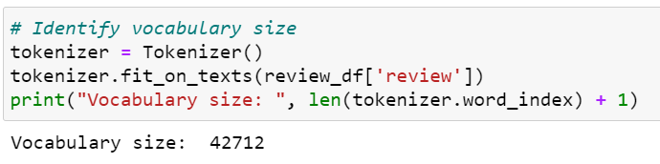
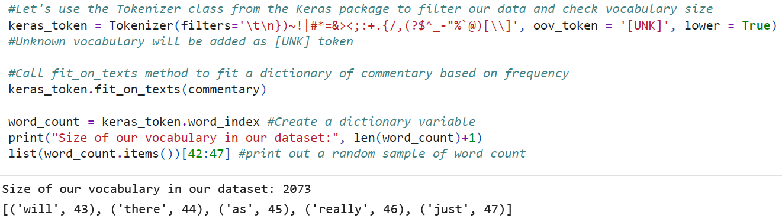
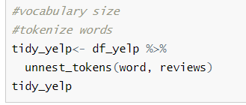
B1b. Vocabulary Size. The vocabulary size is the number of unique or tokenized words featured in your dataset or across all comments.
You can use the Tokenizer class in the Keras library or the Tokenizer method from tensor.keras.preprocessing library to identify the vocabulary size.
The Tokenizer can help remove the special characters using the filter parameter.
See sample Python codes:
See sample R code:
Another Python Code: len(tokenizer.word_index) + 1

Slide 27
B1c. Word embedding length. Word embedding is the position of the word in the learned vector space. It is a mapped vector in a number format that allows a NN to determine the probability distribution of all words and the occurrence of the next word in the vector(Jason Brownlee, Oct.11, 2017).
Embedding length on the other hand is the fourth root of the vocabulary size, which is the squared root of the square root (Qian, 2020). You can take the 4th root of your vocab size and round it up to the nearest integer. This number can be adjusted during hyperparameter tuning for optimal model performance.
The common embedding length that yields the most useful result is between 100 and 300 (Huseby, 2023).
See sample Python codes:
Ex. 1.
max_sequence_embedding = int(round(numpy.sqrt(numpy.sqrt(vocab_size)), 0))
max_sequence_embedding
Ex. 2.
tf.keras.layers.Embedding(NUM_WORDS, EMBEDDING_SIZE)
Brownlee, J. (2021, Feb 02). How to use word embedding layers for deep learning with Keras. https://machinelearningmastery.com/use-word-embedding-layers-deep-learning-keras/

Slide 28
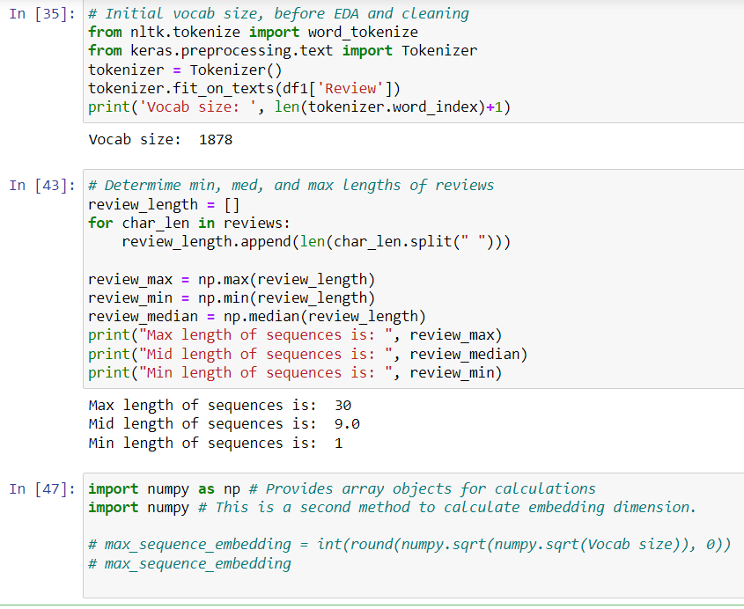
Embedding Length:
Additional Python Codes Examples

Slide 29
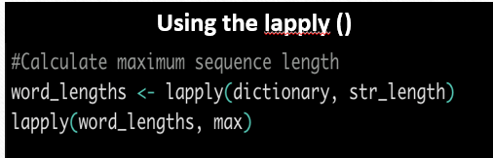
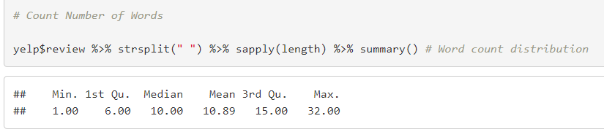
Sample R Code:
Using the sapply ()
Using the bag of Words method:
Word embedding length is the distance of the position of that word from the beginning of the vector.
For example, if in a vector that has 300 spaces, the position of the word is 120 counting from the beginning of the vector, the embedding length of that word is 120 (Brownlee, 2021).
What is Sequence Length?
Is the length of the longest input sentence in the data set used as a text for the model.
The length of a sentence is determined by the maximum number of words in that sentence (Medium, 2020) https://medium.com/@canerkilinc/padding-for-nlp-7dd8598c916a
N/B: You will need to type in a code in Python or R that prints out the maximum length of your sequence from your dataset.

Slide 30
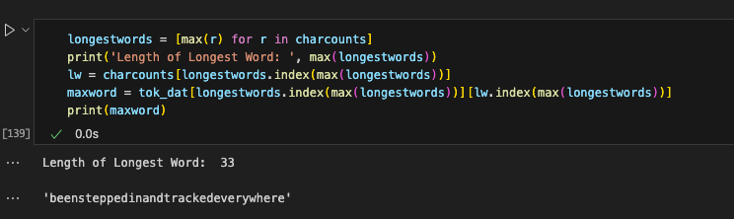
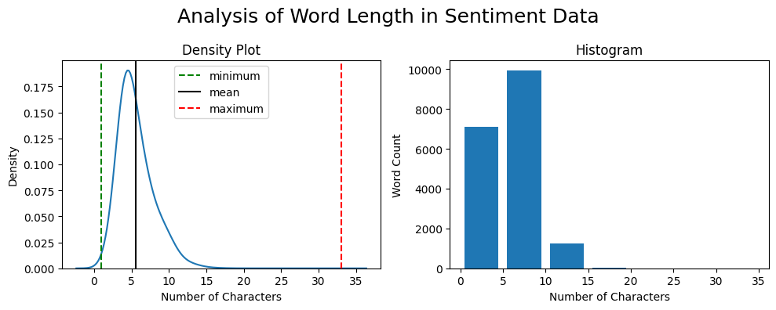
Analysis of Word Length

Slide 31
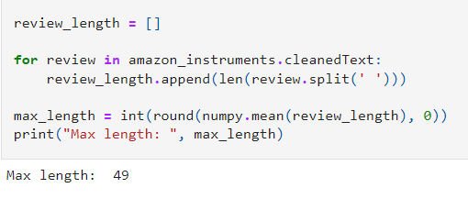
B1d. Statistical justification for the chosen maximum sequence length.
The rationale for choosing the maximum length lies in preserving the available input data so that the generated model doesn't yield conclusions that are likely not to generalize well. Inputs shorter than the
maximum sequence length could be addressed by padding.
Padding to same number of tokens, which in turn means the list of sentences can fit in a matrix. You may essentially rationalize the use of padding as well.
Code Example 1

Slide 32
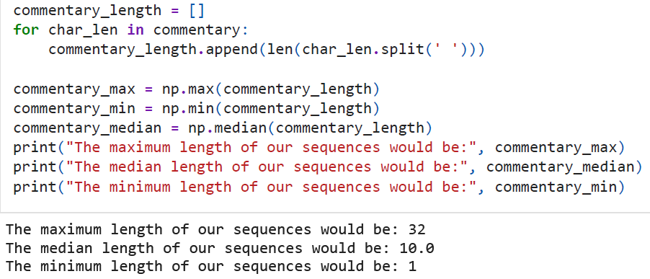
Code Example 2

Slide 33
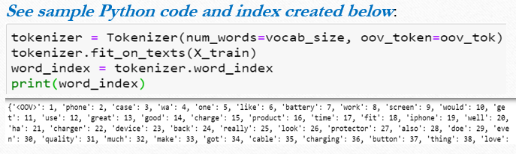
B2. Describe the goals of the tokenization process, including any code generated and packages that are used to normalize text during the tokenization process.
The tokenization process is to separate the text into smaller chunks or tokens. The chunks can be words, characters, or sub-word. A unique index called "word_index" is assigned to each word in the text which helps the model during the training process (TensorFlow, n.d; MLK, 2021). The Tokenizer method from tensorflow.keras needs to be first imported.
Other goals that the tokenization process can achieve include:
Replacing any abnormal character, formatting, and standardizing texts,
Lemmatizing words and transforming the text into sequences, and
Preparing the transformed sequences to a maximum sequence length by padding.

Slide 34
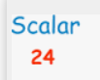
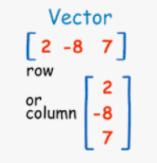
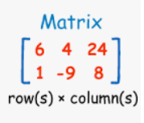
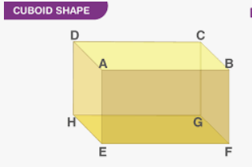
B3. Padding process used to standardize the length of sequences.
Padding is a technique in NN used to improve performance by preserving the shape of tensor dimensions. 1D is a vector, 2D a matrix, 3D a cuboid.
The length of each D is a shape. Therefore, NN requires that the input provided be of the same shape and size. Since every sentence could have a different length of words, we need to perform padding to make all the input sentences of the same size.
In Python, you can use the pad_sequences library from tensorflow.keras.preprocessing.sequence.

Slide 35
B4. Identify how many categories of sentiment will be used and an activation function for the final dense layer of the network.
You can set the labels for your data set to 0 and 1. 0 = Negative review and 1 = Positive review. In that case, you have two categories that could be used for sentiment analysis output in the neural network output layer (Analytics Vidhya, 2021).
You can use softmax as the activation function. The softmax function calculates the relative probabilities.

Slide 36
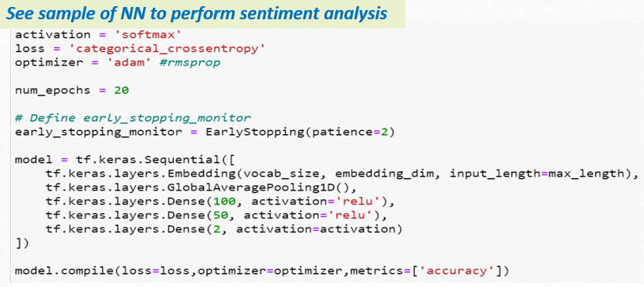

Slide 37
B5. Explain the steps used to prepare the data for analysis, including the size of the training, validation, and test set split.
List and explain the steps e.g.
1. Read the data from the dataset or from all three sources.
2. Check on unusual or any abnormal characters
3. Clean the data
4. Explore the data
5. Create a two-dimensional NumPy array with our ratings by encoding
6. Split data into training and testing sets with an 80/20 split
7. On the training set, apply the tokenizer using the fit_on texts() method
8. Retrieve the word_index of the training set.
9. Pre-padding/post-padding the sequence to get the maximum length needed.
10. Fit the final model, convert both the training set and the testing set into arrays using NumPy
The rule of thumb for splitting data is 80/20. Empirical studies show that the best results are obtained if we use 20-30% of the data for testing, and the remaining 70-80% of the data for training (Gholamy, Kreinovich, & Kosheleva, 2018). If you intend to split into three it is common to allocate 50% training, 25% test set, and 25% validation.

Slide 38
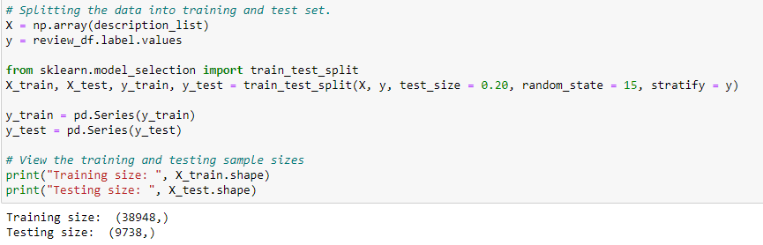
Sample Python codes for splitting

Slide 39
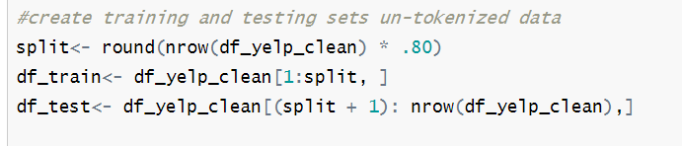
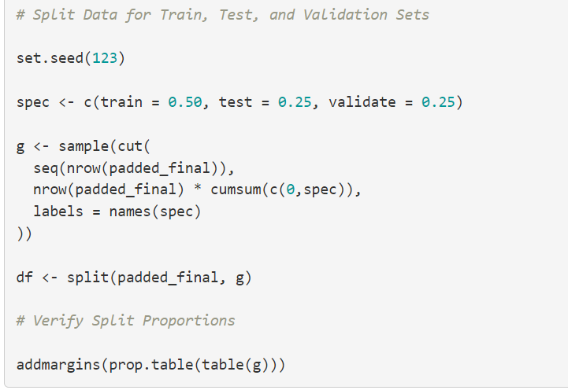
Code to split the data in R.
Ex 1 in R
Ex 2 in R
Code and video to convert corpus into dataframe in R. http://machinelr.blogspot.com/2016/09/convert-corpus-into-data-frame-in-r.html

Slide 40
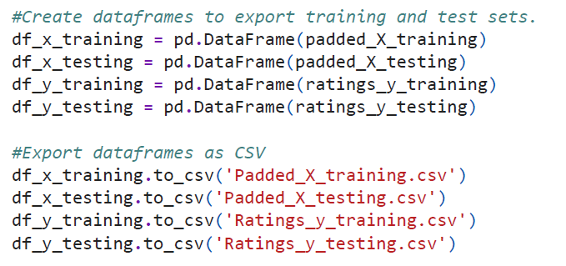
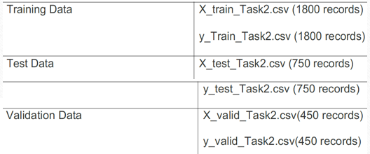
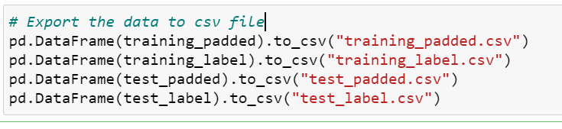
B6. Provide a copy of the prepared dataset.
Other Sample Python codes for exporting the prepared dataset in Python

Slide 41
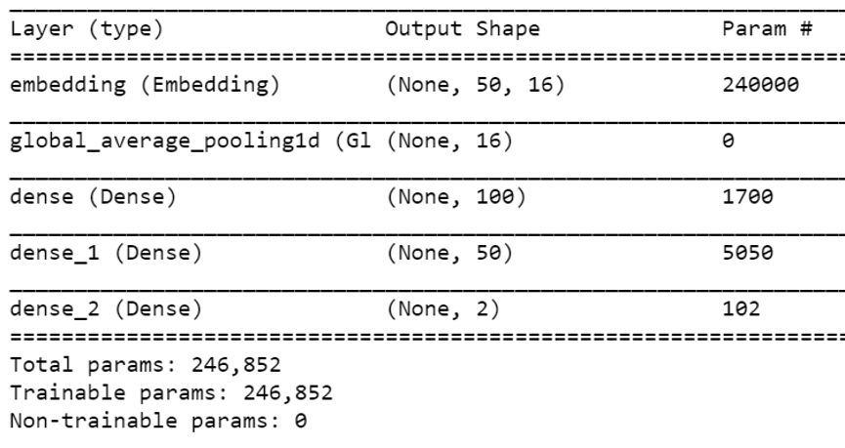
Part III: Network Architecture
C. Describe the type of network used by doing the following:
C1. Provide the output of the model summary of the function from TensorFlow.
The model.summary() method provides a summary of the model and a quick way to visualize the components of the Keras model. It provides the names of the layers, their type, shape, and the number of trainable parameters (MachineCurve, 2020).
Keras Model Summary
This output will reflect on the type of NN used. For instance, RNN will have 3 Layers (input, hidden, and output). The output layer cannot be set to 2 because the final layer will aim to predict one of the binary results.

Slide 42
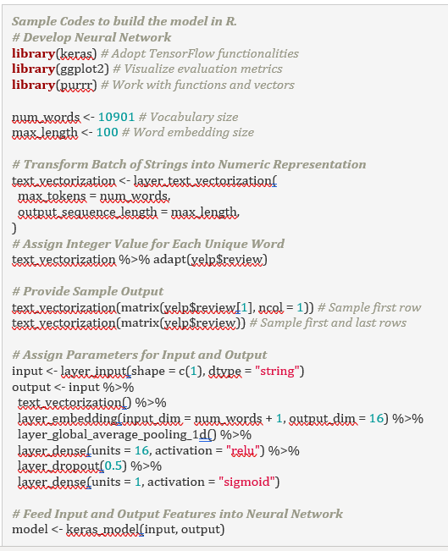
Sample R Codes to Build a NN:
Transform batch of strings into a numeric representation.
Assign integer values for each unique word
Provide sample output
Assign parameters for input and output
Feed input and output features into NN.

Slide 43
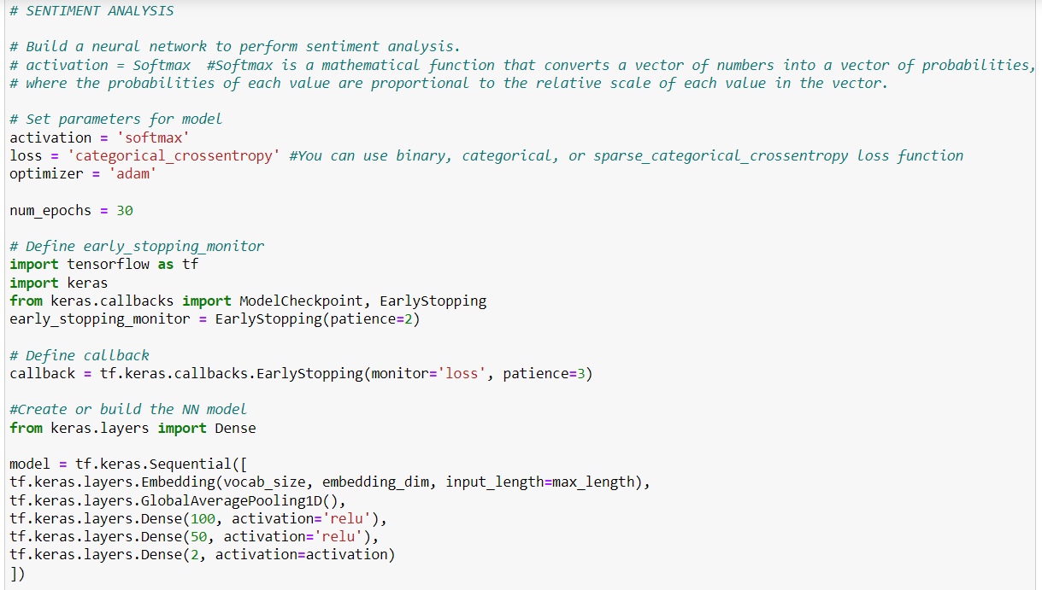
Sample Python Code to build NN

Slide 44
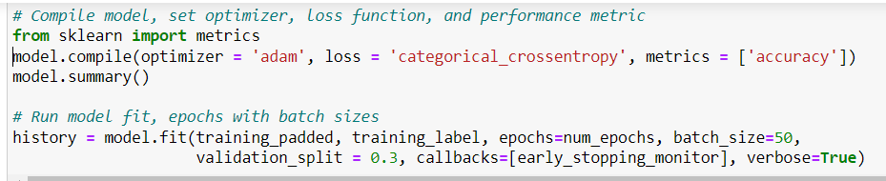
Fitting the model in Python Example 1
Fitting the model in Python Example 2
Fitting the model in Python Example 3

Slide 45
Note on Keras, TensorFlow, & Neural Network:
Keras is a neural network API for Python that runs on top of TensorFlow, which is used to build machine learning models. Keras' models offer a simple, user-friendly way to define a neural network, which will then be built for you by TensorFlow. Keras uses the simple Sequential API, advanced Functional API, and more advanced Subclassing modes to create the model.
TensorFlow is an open-source set of libraries to help you develop and train ML models such as neural networks. It’s best used when you have a need for Machine Learning, deep learning research, complex neural networks, working with large datasets, and high-performance models. It has:
Easy ML model building
Robust ML production anywhere
Powerful experimentation for research
Tensors represent deep learning data. They are multidimensional arrays, used to store multiple dimensions of a dataset. Each dimension is called a feature. For example, a cube storing data across an X, Y, and Z access is represented as a 3-dimensional tensor.
Visit https://www.tensorflow.org/ to learn more about Tensorflow.
Source: https://www.activestate.com/resources/quick-reads/what-is-a-keras-model/

Slide 46
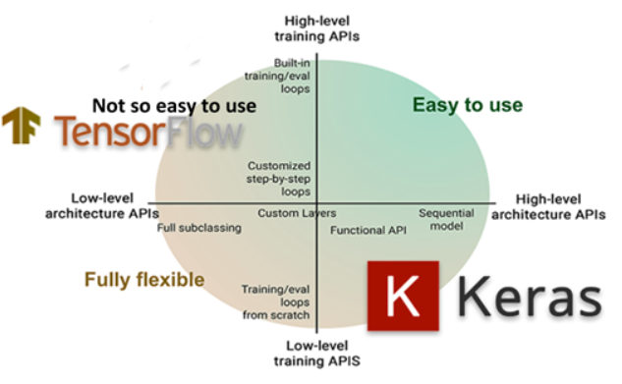
Sentiment Analysis: In B2, you are required to describe your tokenization process. Tokenization means separating the text into smaller chunks or tokens. You will need to import the Tokenizer method from tensorflow.keras. The Tensors are multidimensional arrays, used to store multiple dimensions of a dataset.
Neural Network: C1 requires you to provide the output of the model summary of the function from TensorFlow. Keras is a neural network API for Python that runs on top of TensorFlow, which is used to build machine learning models. It is a set of libraries that help you develop and train ML models such as neural networks.
# Import the Keras libraries:
from keras.models import Sequential
from keras.layers import Dense, Activation
# Create a Sequential model:
model = Sequential()
# Add layers with the add() method:
model.add(Dense(32, input_dim=784))
model.add(Activation('relu'))
References:
1. https://towardsdatascience.com/a-complete-step-by-step-tutorial-on-sentiment-analysis-in-keras-and-tensorflow-ea420cc8913f
2. https://www.tensorflow.org/tfx/tutorials/transform/census

Slide 47
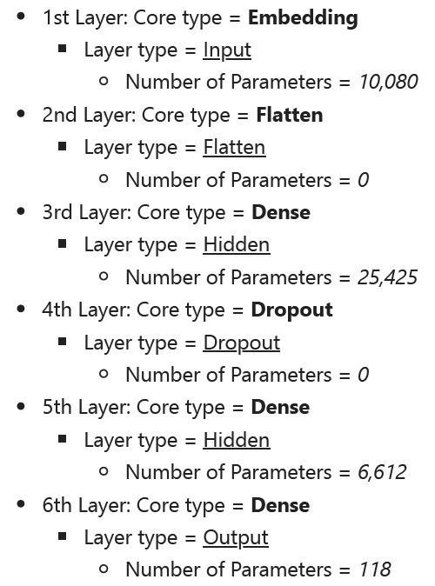
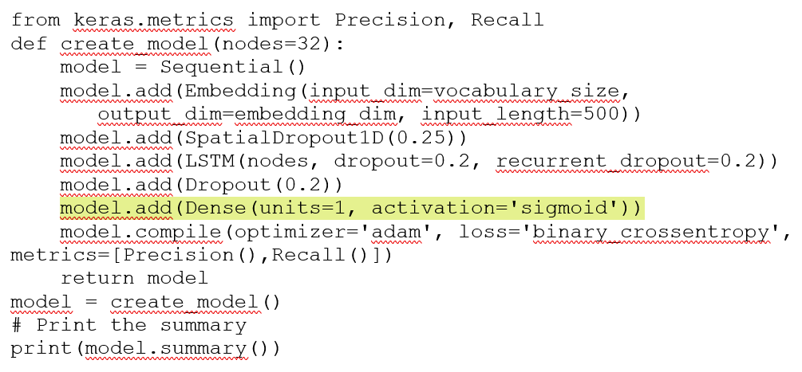
C2. Discuss the number of layers, the type of layers, and total number of parameters.
You may have modeled a neural network with six total layers and 41,722 trainable parameters as shown in the adjacent summary.
If you want to use the dense with units, then you need to add another value so that the model can predict more than one value.

Slide 48
C3. Justify the choice of hyperparameters including the following elements: activation functions,
number of nodes per layer, loss function, optimizer, stopping criteria, and evaluation metric.
The activation function transforms the output from one layer to the other.
C3a. Activation functions: Sigmoid, SoftMax, ReLu, etc. Explain how you apply activation functions to the layers.
The Sigmoid function is good for binary classification problems since it exists between 0 and 1, allowing it to predict the probability of an output corresponding to a binary class (Karakaya, 2020).
The SoftMax could activate the final dense output layer of the neural network if Sigmoid produced less accurate final results. Activation by SoftMax logistically involves the generalization of inputs to yield results as probabilities summing close to 1 or 0.
The Rectified Linear Activation (ReLu) function is commonly used for hidden layers. It is simple to implement and effective at overcoming the limitations of other activation functions. It is a better choice for hidden dense layers if the neural network must consider more than two types of sentiments.

Slide 49
C3b. Number of nodes per layer : Explain how you construct your embedding layer in your neural network, how many nodes for the layers, etc.
HOW TO CHOOSE THE NUMBER OF NODES PER LAYER
Choosing the number of nodes per layer can be done by experiment. You can start with 1 hidden layer of say 50 nodes, then gradually increase the number of hidden layers and nodes as the model accuracy improves.
When you notice that adding more capacity to the network is no longer improving the accuracy, you can stop adding nodes and layers.
Sometimes, determining the number of nodes can be based on intuition when you know more about the problem domain. For instance, if you are trying to predict 2 outputs maybe 0 for negative and 1 for positive, your output layer will have two nodes.

Slide 50
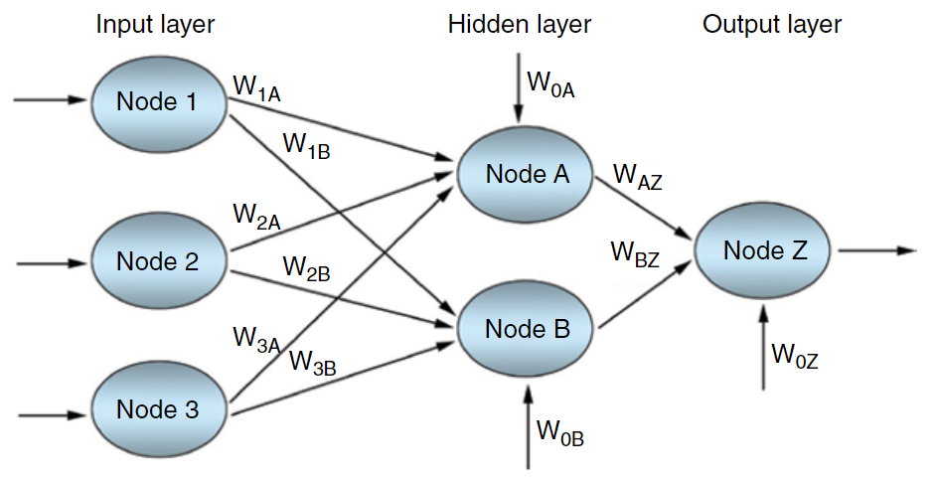
C3b. A number of nodes per layer: Explain how you construct your embedding layer in your neural network, how many nodes for the layers, etc. Sometimes, determining the number of nodes can also be based on intuition when you know more about the problem domain.
Sample Neural Network with Layers and Nodes

Slide 51
C3c. Loss function
You can use binary, categorical crossentropy, or sparse_categorical_crossentropy as the loss function. Binary crossentropy is good for classification analysis, for those whose rating sentiments operate a binary 1 or 0 classification. Categorical crossentropy is used for multi-class classification problems and works on an integer target. It is designed to quantify the difference between two probability distributions. Sparse_categorical_crossentropy' works on an integer target and produces a category index of the most likely matching category.
C3d. Optimizer
The “adam” optimizer is more popular than other optimization algorithms used in deep learning. The Adam algorithm is an extension to stochastic gradient descent which updates network weights iteratively based on training data. It performs better than stochastic gradient descent itself. It is easy and straightforward to implement, quick and computationally efficient, and uses less memory (Brownlee, 2021). Adam combines the best aspects of other algorithms, such as the scaled learning rate of RMSprop and the utilization of momentum like SGD and AdaGrad (Bushaev, 2018). Due to its iterative nature towards adjusting weights, Adam also has a high level of adaptability and is able to handle noise in the input model well, thus reducing overfitting.

Slide 52
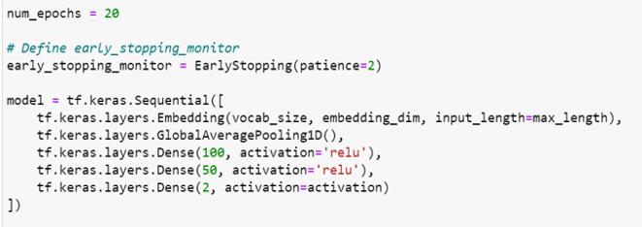
C3e. Stopping Criteria – You can use early stopping criteria to stop the neural network from overfitting the training data to improve generalization in the final model (Brownlee, 2018). Early Stopping monitors the validation accuracy score and stops training early in the event validation accuracy does not increase after 7 successive epochs. Early stopping monitor stops the training as soon as the validation score isn't improving. The monitor takes an argument for example ‘patience’, which is how many epochs the model can go without improving before we stop training, generally, 2 or 3 is a good value for patience.
Epoch: By default, Keras trains for 10 epochs but you can provide a higher value for epoch and also provide an early stopping monitor which is a smarter logic to use for training the models.

Slide 53

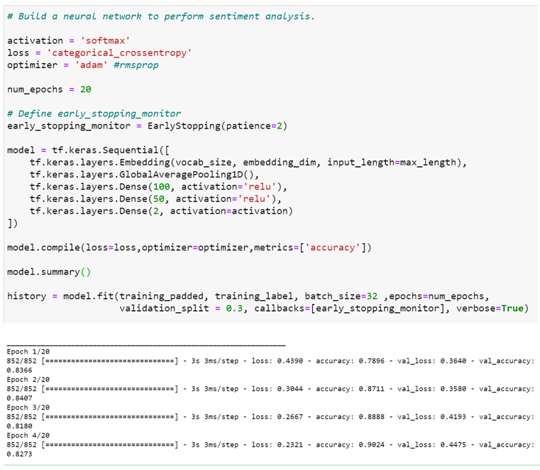
C3e Cont’d
Sample Code for:
Activation Function,
Loss Function,
Optmizer,
Epochs,
Early Stopping Criteria, and
Model Summary

Slide 54
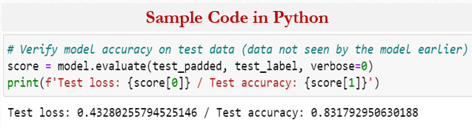
C3f. Evaluation Metric. You can use “accuracy” as the metric to evaluate how well your NN can classify comments based on sentiment with your training dataset. With your test set, you can use ‘accuracy’ to determine if your model was at risk for overfitting. Then tell the evaluator your accuracy scores after training e.g., training accuracy(95%), validation accuracy(85%), and testing accuracy (81%).
Classification accuracy is the ratio of the number of correct predictions to the total number of input samples. This means that, after the model has gone through training, it can correctly predict the output based on the input about 80% of the time.

Slide 55
Part IV: Model Evaluation
D. Evaluate the model training process and its relevant outcomes by doing the following:
1. Discuss the impact of using stopping criteria instead of defining the number of epochs, including a screenshot showing the final training epoch.
2. Provide visualizations of the model’s training process, including a line graph of the loss and chosen evaluation metric.
3. Assess the fitness of the model and any measures taken to address overfitting.
4. Discuss the predictive accuracy of the trained network.
D1. Discuss the impact of using stopping criteria instead of defining the number of epochs, including a screenshot showing the final training epoch.
When you provide the number of epochs say 10, the model will continue to get trained from the first epoch to the max epoch provided.
Sometimes validation scores drop, and the epoch training continues.
Providing a higher epoch could be an option but how do you know how much more you need?
So, the smarter idea is to use an early stopping monitor to stop the training as soon as the validation score isn’t improving.
The monitor takes an argument called patience, which is how many epochs the model can go without improving before you stop training, generally, 2 or 3 is a good value for patience.
You can pass the early stopping monitor to the fit function under an argument called callbacks.

Slide 56
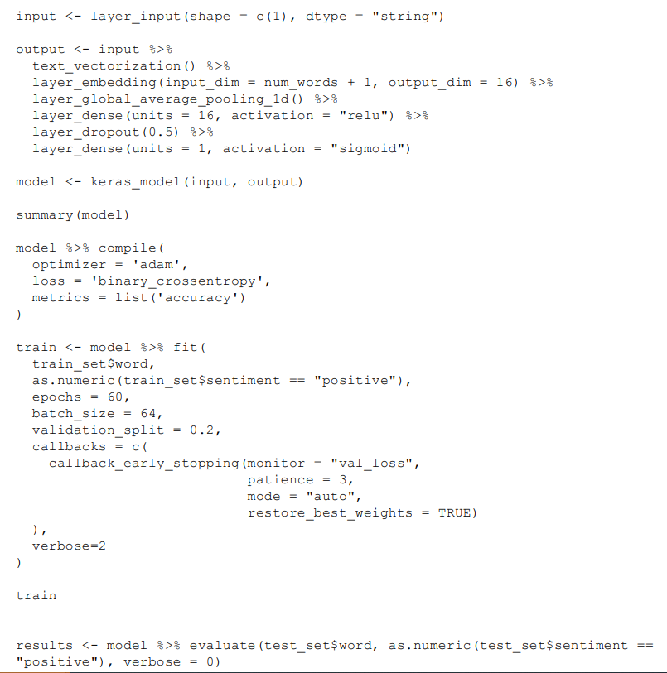
How to create Keras Sequential Neural Network in R
Method 1:
Bharatendra Rai (n.d). Deep Learning with Keras & TensorFlow in R. How to create Keras Sequential Model in R.

Slide 57
D2. Assess the fitness of the model and any measures taken
to address overfitting and underfitting.
Overfitting
Means that the model has paid too much attention to the training data so much that it cannot adapt to new data. In other words, the model learns the training dataset too well that it performs so well on the training dataset but does not perform well on the testing dataset
Measures that you can take to avoid overfitting may include:
Starting first with a smaller network and then increasing the capacity of the network as it seems to improve by adding more layers and nodes to the layers.
You can reduce the number of epochs to prevent the risk of overfitting the model or set up the stopping criteria.
Let the evaluator know how your model can be further improved may be by providing more data for training and optimizing the network further (Brownlee, 2019).

Slide 58
D2 Cont’d
Underfitting
Underfitting on the other hand means that the model is unable to capture the trend/pattern or the fundamental logic of the data.
Measures to address underfitting may include:
If the accuracy of the validation data being is low about 50% or less, it undermines the fitness of this model.
If the value of loss for the validation data has not decreased at the same pace as the value of loss for the training, it further undermines the fitness of the model. As a result, you want to take some measures to fit the model.
One method is to insert a dropout layer between the hidden dense layers so that several layer outputs dropped out randomly, which has the effect of each update to a layer being performed with a different view of the configured layer during training.

Slide 59
If they want, you to provide evidence of an improved model. What was accuracy score on the training and test data sets before it improved to what you currently have.
Example:
Initial Model Performance | Training Accuracy (in %) | Test Accuracy (in %)
Recurrent Neural Network (RNN) | 98.70 | 70.51
Final Model Performance | Training Accuracy (in %) | Test Accuracy (in %)
Recurrent Neural Network (RNN) | 96.70 | 96.30
What actions did you take to make that happen?
Example Actions:
Adding more layers and/or nodes: Starting first with a smaller network and then increasing the capacity of the network as it seems to improve by adding more layers and nodes to the layers.
Epoch: You can reduce the number of epochs to prevent the risk of overfitting the model or set up the stopping criteria.
Well-Fitted Model
If your model did not overfit, you can say so by stating something like: The final model results performed similarly on the test data to what it had on the training data. The model returned an accuracy score on the train data of 90.7 and an accuracy score on the test data of 90.5 With the model performance being so similar, there does not seem to be an overfitting issue.

Slide 60
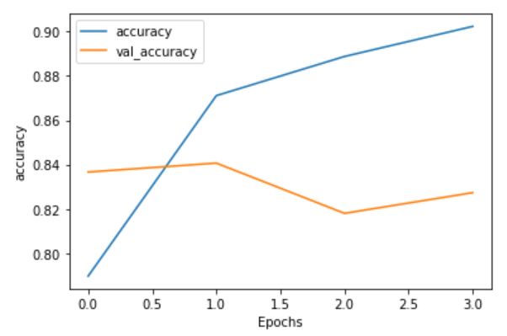
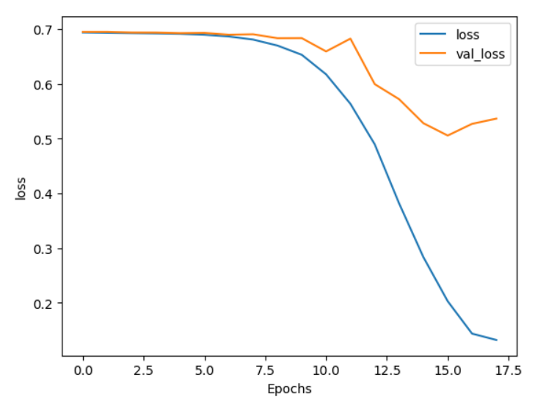
Visualizations
D3. Provide visualizations of the model’s training process, including a line graph of the loss and chosen evaluation metric.

Slide 61
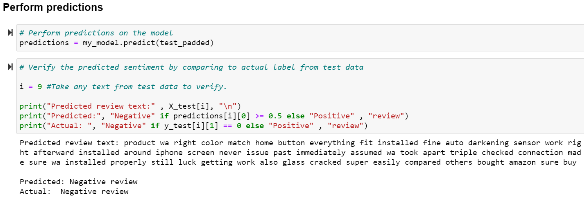

D4. Discuss the predictive accuracy of the trained network.
Tell us how accurate is your model prediction on the trained set. You can use the test and validation datasets to evaluate your model's accuracy. You can use the evaluate() function in Keras. State your prediction loss and accuracy numbers.
Sample code in Python of how to use neural network to predict the sentiment from the review.
Sample code in Python of how to verify model accuracy.

Slide 62


Part V: Summary and Recommendations
E. Provide the code used to save the trained network within the neural network.
F. Discuss the functionality of your neural network, including the impact of the network architecture.
G. Recommend a course of action based on your results.
E. Provide the code used to save the trained network within the neural network.
You can save or export your neural network model. The sample codes below can be used to save the trained network within the neural network. You can submit with or without the summary output from the code.

Slide 63
F. Discuss the functionality of your neural network, including the impact of the network architecture.
Functionality:
You can mention how many customer reviews (e. g., 40,000) your model uses as an input to train, that you validated and tested the model.
Talk about how you use NLP to analyze the sentiments of the customers from the review.
Your model was trained using the customer reviews and their actual sentiments recorded as labels.
Based on that your model may have been tuned to perform prediction on new customer reviews to identify customer sentiments if they are positive or negative reviews.
Impact:
You can state what the network architecture of your neural network helped you with.
For example, using the type of architecture you had, helped you detect the sentiment of your reviews with an acceptable degree of accuracy.
G. Recommend a course of action based on your results.

Slide 64
Part VI: Reporting.
H. Show your neural network in an industry-relevant interactive development environment (e.g., an R Markdown document, a Jupyter Notebook, etc.). Include a PDF or HTML document of your executed notebook presentation.
Sometime, the evaluator will return your work for revision saying that “The submission provides a word document, a Python code, and a Jupyter notebook with the code. A PDF or HTML document is not readily evident” That simply means, you need to save the Jupyter notebook as a pdf or html because they may not be able to open the ipynb file extension. The following link shows how to export your Jupyter Notebook to html or PDF. https://jupyterlab.readthedocs.io/en/stable/user/export.html
I. List the web sources used to acquire data or segments of third-party code to support the application.
J. Acknowledge sources, using in-text citations and references, for content that is quoted, paraphrased or summarized.
K. Demonstrate professional communication in the content and presentation of your submission.

Slide 65
Q & A
Question: Why will every time I re-run the model it gives me a different result on the stop epoch point? And how can I prevent it from stopping at one point only?
If you set up an epoch your model training will stop at that epoch whether your model validation scores improve or not. If you set up early stopping criteria, it will stop whenever your validation is no longer improving whether it ran the number of epochs set or not.
Since you set early stopping criteria, you might want to play with your patient argument to see if it makes any difference. The monitor takes an argument called patience, which is how many epochs the model can go without improving before you stop training, generally, 2 or 3 is a good value for patience.
https://machinelearningmastery.com/use-word-embedding-layers-deep-learning-keras/

Slide 66
Should I remove stop words from my dataset?
There is no requirement to remove Stop Words. Stop words are used to eliminate unimportant words, allowing your model to focus on the important words instead. If you do not think it is necessary to help your model performance, then you can leave it on.
The task doesn't seem to address lemmatization or stemming, why should I do it?
Stemming is part of the tokenization process. It helps reduce a word to its root to normalize vocabulary. Specifically, a word loses its suffix so that other words that derive from the same root become standardized and comparable. However, there are disadvantages to this method. Over-stemming can occur, where two words from different stems result in the same root and cause a false positive. Under-stemming can also occur, where two words from the same stem result in different roots and cause a false negative. Stemming could also introduce confusion, as the stemmed words do not always revert to their dictionary roots. Based on the pros and cons, you can make the decision to lemmatize or not.

Slide 67

What is Bag of words?
Is a type of model in NLP, the other is the N-gram. Bag of words is a method for creating a vector from a document. It works by counting up all the words in a document and assigning each word in the chosen vocabulary to a position in a vector representation.
This is one hot encoding the words (one position for each word in the vocabulary) and then adding up the vectors to get the bag of words representation of the document.
In bag of words, the length of the vector is equivalent with the size of the vocabulary and each word is represented as one position in the vector.
Huseby, K. H. (Jun 30, 2020)

Slide 68
What is Word embedding Length?
Word embedding is the position of the word in the learned vector space. The most common dimensions for word embedding are 128 and 256, which fall under the accepted range between 50 and 300. While the embedding dimension can be increased beyond this range, doing so does not increase accuracy in a statistically significant manner (Patel & Bhattacharyya, 2017).
Embedding Length
Is the distance of the position of that word from the beginning of the vector. For example, if in a vector that has 300 spaces, the position of the word is 120 counting from the beginning of the vector, the embedding length of that word is 120 (Brownlee, 2021).
Another rule of thumb is to calculate the fourth root of the vocabulary size, which is the squared root of the square root (Qian, 2020; Brownlee, 2021).
Brownlee, J. (2021, Feb 02). How to use word embedding layers for deep learning with keras. https://machinelearningmastery.com/use-word-embedding-layers-deep-learning-keras/

Slide 69
What is Sequence Length?
On the other hand, the sequence length is the length of the longest input sentence in the data set used as text for the model.
The length of a sentence is determined by the maximum number of words in that sentence (Medium, 2020) https://medium.com/@canerkilinc/padding-for-nlp-7dd8598c916a
You will type in a code in Python or R that prints out the maximum length of your sequence from your dataset.
Dimensionality in word embeddings refers to the length of these vectors.
https://stackoverflow.com/questions/45394949/what-is-dimensionality-in-word-embeddings

Slide 70
Value Error fitting the model
I am having value error:“ValueError: Shapes (None, 1) and (None, 2) are incompatible”
This error may refer to the loss argument in the compile method.
model.compile(loss = 'categorical_crossentropy', optimizer = 'adam', metrics = ['accuracy'])
Changing the loss to 'sparse_categorical_crossentropy’ may solve the problem.
model.compile(loss = 'sparse_categorical_crossentropy', optimizer = 'adam', metrics = ['accuracy'])
The error arose because 'categorical_crossentropy' works on a one-hot encoded target, while 'sparse_categorical_crossentropy' works on an integer target.
Also, categorical_crossentropy ( cce ) produces a one-hot array containing the probable match for each category, while sparse_categorical_crossentropy ( scce ) produces a category index of the most likely matching category.
In R, Model %>% compile(loss = keras :: loss_sparse_categorical_crossentropy( ),
https://www.kaggle.com/general/197993

Slide 71
ValueError: Found input variables with inconsistent numbers of samples: [331315, 331193]
The shape of your X_train, Y_train or X_test, Y_test are not in alignment. Variable shapes are Scaler, 1D, 2D, 3D. Do X_train.shape to see the shape of the X_train, etc. Then use the variables with the same shape.
AlreadyExistsError: The “AlreadyExistsError” occurs when you try to define a metric with the same name as an existing metric in your Tensorflow model. A metric is a function that is used to evaluate the performance of your model.
How to fix it: Check the names of the existing metrics in your Tensorflow model and if it matches the name of your custom metric, change it. You can do this by running the following code:
import tensorflow as tf
print(tf.keras.metrics.get_all())
This code will print a list of all the built-in metrics in your Tensorflow version, along with their names and attributes. You can then rename them.
How to fix AlreadyExistsError in TensorFlow

Slide 72
Binary cross-entropy is for binary classification and categorical cross-entropy is for multi-class classification, but both work for binary classification. If it doesn’t work for you, you can review the information on this link. It may give you additional information on binary_crossentroy.
https://androidkt.com/choose-cross-entropy-loss-function-in-keras/
Why do you have 2 nodes at the last Dense layer but other examples have 1?
If you check your model summary, it will tell you the number of nodes in your Dense layer. You can have as many nodes as you want in the Dense layer depending on the size of the feature map and others. In NN, each layer is made up of nodes (1, 2, 3, etc.). Each node in a layer is defined by its weight values. A node (neuron or perceptron) is a computational unit with one or more weighted input connections. The dense layer contains nodes (neurons) in which each receives input from all the neurons of the previous layer.

Slide 73
AttributeError Getting Attribute Error in my code, what does it mean?
AttributeError can be defined as an error that is raised when an attribute reference or assignment fails. To solve these errors, first check that the attribute you are calling exists. Then, make sure the attribute is related to the object or data type with which you are working.
For example, if we take a variable x we are assigned a value of 10. In this process suppose we want to append another value to that variable. It’s not possible. Because the variable is an integer type it does not support the append method. Link: AttributeError
Example 1: An integer value does not support the append() method.
TwoPython programs to demonstrate AttributeError
X = 10
X.append(6)
## AttributeError: 'int' object has no attribute 'append'
append() method adds an additional element to the end of the variable X, but the value of X is an integer that does not support the append() method.

Slide 74
Example 2: Python is case-sensitive, variation in spelling causes AttributeError.
string = "The famous website is { }".fst("geeksforgeeks")
print(string)
## AttributeError: 'str' object has no attribute 'fst’
https://www.geeksforgeeks.org/python-attributeerror/
https://careerkarma.com/blog/python-attributeerror/#:~:text=Attribute%20errors%20in%20Python%20are,with%20which%20you%20are%20working.
data = vectorizer.fit_transform(mealarray.ravel())
CountVectorizer is taking lists (with string contents) as an argument rather than array. That solved my problem.
https://stackoverflow.com/questions/26367075/countvectorizer-attributeerror-numpy-ndarray-object-has-no-attribute-lower

Slide 75
Code Errors and Fixes - Python
TypeError: expected string or bytes-like object
The Python TypeError : expected string or bytes-like object" occurs when we pass an argument of a different type to a method that expects a string argument, e.g. re. sub() . To solve the error, make sure to pass a string argument to the method.
When fitting the model, you get ’Cast string to float is not supported’
SIMPLE TO FIX, just use the following code to change the data type of your Target Variable to int,
df[“x_train"] = df[“y_train"].astype(str).astype(int)
df[“x_test"] = df[“y_tets"].astype(str).astype(int)

Slide 76
Task 2
REFERENCE SECTION

Slide 77
Python
Brownlee, J. (2021, Feb 02). How to use word embedding layers for deep learning with keras. https://machinelearningmastery.com/use-word-embedding-layers-deep-learning-keras/
https://developers.googleblog.com/2017/11/introducing-tensorflow-feature-columns.html
Heaton, J. (Jun 6, 2019). Early stopping in Keras to prevent overfitting. https://www.youtube.com/watch?v=m1LNunuI2fk
Huseby, K. H. (Jun 30, 2020). Word embeddings, what are they really? Retrieved Nov 21, 2021, from https://towardsdatascience.com/word-embeddings-what-are-they-really-f106e1ff0874
Kale, M. (2020, August 13). Natural Language Processing in Python – Simple Example. Mikes Website. https://www.mikekale.com/natural-language-processing-in-python-simple-example/.
Monkeylearn.com. (2020). Sentiment Analysis – The Go-To Guide. MonkeyLearn. https://monkeylearn.com/sentiment-analysis/.
Natural Language Processing - Python. Tutorialspoint. (n.d.). https://www.tutorialspoint.com/natural_language_processing/natural_language_processing_python.htm.

Slide 78
Python Cont’d
Gholamy, A., Kreinovich, V., & Kosheleva, O. (Feb, 2018). Why 70/30 or 80/20 relation between training and testing sets: A pedagogical explanation. Technical Report: UTEP-CS-18-09. University of Texas at
Elpaso.Retrieved 11/12/2021 from https://scholarworks.utep.edu/cgi/viewcontent.cgi?article=2202&context=cs_techrep
https://www.tensorflow.org/api_docs/python/tf/keras/Model
Zach’s video about building and fitting the model:
https://www.youtube.com/watch?v=08-ml-TGLLY
RNN for Sequential data Video: https://www.youtube.com/watch?v=z9p397QMZdU
Video: Gradient descent, how neural networks learn. https://www.youtube.com/watch?v=IHZwWFHWa-w
Deep Learning and Sequential Data: https://www.youtube.com/watch?v=VlMZ8YKKabM

Slide 79
R Language
1. Bharatendra Rai (n.d). Deep Learning with Keras & TensorFlow in R. How to create Keras Sequential Model in R.
1.1. Datacamp (2019, December, 9). Neural Network Models in R. Retrieved from https://www.datacamp.com/community/tutorials/neural-network-models-r
2. GeeksforGeeks, (2020, Aug., 20): Building a simple neural network in R programming. Retrieved from: https://www.geeksforgeeks.org/building-a-simple-neural-network-in-r-programming/
Team, G. L. (2020, September 1). Activation Functions in Neural Networks. Retrieved from https://www.mygreatlearning.com/blog/activation-functions/#:~:text=%20Activation%20Functions%20in%20Neural%20Networks%20Explained%20,function%20is%20generally%20used%20in%20the...%20More%20.
Tamakloe, E. E. (2019). Neural Net in R. Sigmoid and Softmax from scratch. Retrieved from https://www.kaggle.com/tamaklee/neural-net-in-r-sigmoid-and-softmax-from-scratch
4. Verma, A. (2020, Jul, 20). Building a neural net from scratch using R – part 1. Retrieved from https://rviews.rstudio.com/2020/07/20/shallow-neural-net-from-scratch-using-r-part-1/

Slide 80
R Language Cont’d
The TensorFlow Authors and RStudio, PBC (2020). Text Classification. Retrieved from https://tensorflow.rstudio.com/tutorials/beginners/basic-ml/tutorial_basic_text_classification/
Golding, N., & Kalonowski, T. (2022). R interface to Tensorflow. https://cran.r-project.org/web/packages/tensorflow/tensorflow.pdf
Couch, A. (2021). TidyTuesday: Big Data Machine Learning with TidyModels and Spark https://www.youtube.com/watch?v=gfvNln7uAuQ
Teja, S. (2020, June 7). NLP with TensorFlow. https://medium.com/@saitejaponugoti/nlp-natural-language-processing-with-tensorflow-b2751aa8c460
This blog has some good softmax codes. Scroll down to get there. https://www.r-bloggers.com/2021/04/not-so-soft-softmax/
https://tensorflow.rstudio.com/installation/

Slide 81
Deep Learning with Keras & TensorFlow in R
Video on onehot encoding, creating, fitting, evaluating the model, etc.- very good video on everything.
https://www.youtube.com/watch?v=hd81EH1g1bE
Additional Resources on Sentiment Analysis
https://monkeylearn.com/sentiment-analysis/
https://www.freecodecamp.org/news/what-is-sentiment-analysis-a-complete-guide-to-for-beginners/
https://www.geeksforgeeks.org/what-is-sentiment-analysis/
https://careerfoundry.com/en/blog/data-analytics/sentiment-analysis/
For R Installation
https://tensorflow.rstudio.com/installation/
https://cran.r-project.org/web/packages/tensorflow/tensorflow.pdf
Download Link: https://cran.r-project.org/bin/windows/base/

Slide 82


Slide 83
Installing TensorFlow on Mac
Narayana, S. (2022). Install TensorFlow on Apple M1 (M1, Pro, Max) with GPU (Metal. https://sudhanva.me/install-tensorflow-on-apple-m1-pro-max/
(2) 2021, Installing TensorFlow 2.4, Keras, & Python 3.8 in Mac OSX Intel – YouTube
Good Link: Installing Tensorflow2.4
Other Resources
Musstafa, A. (2021, March 27). Optimizers in Deep Learning. Medium. Retrieved November 27, 2021, from https://medium.com/mlearning-ai/optimizers-in-deep-learning-7bf81fed78a0
Saeed, M. (2021, September 24). An Introduction to Recurrent Neural Networks and the Math that Powers Them. Machine Learning Mastery. Retrieved November 23, 2021, from https://machinelearningmastery.com/an-introduction-to-recurrent-neural-networks-and-the-math-that-powers-them/.
Sreekanth, T. (2020, August 26). Activation Functions in Neural Networks Explained. Great Learning. Retrieved November 25, 2021, from https://www.mygreatlearning.com/blog/activation-functions/.

Slide 84
Important Notes
Plagiarism. Your submission must be your original work. No more than a combined total of 30% of the submission and no more than a 10% match to any one individual source can be directly quoted or closely paraphrased from sources, even if cited correctly.
Rubric. You must use the rubric as a guide to direct the creation of your submission because it provides detailed criteria that will be used to evaluate your work.
Submissions. Tasks may not be submitted as cloud links, such as links to Google Docs, Google Slides, OneDrive, etc. unless specified in the task requirements. All other submissions must be file types that are uploaded and submitted as attachments (e.g., .docx, .pdf, .ppt).

Slide 85
Course Cohort
Webinar
Cohort Webinar Reminder!!!
Don’t forget to join the Cohort Webinar for D213-Advanced Data Analytics today Sunday. The session holds on the 3rd Sunday of every month. Time: 1:00 PM MT, 2:00 PM CT, and 3:00 PM ET.
Link:
https://srm.my.salesforce.com/apex/CohortLiveEvent?id=a2w3x00000GWd2Z https://srm.my.salesforce.com/apex/CohortLiveEvent?cohortId=a2y3x000003f6DP
If prompted:
Session Number: 120 095 4238
Session Password: d213
If you have not registered, please do so on the D213 Course Homepage.
Under Cohort sign-up:
· Click on EXPLORE COHORT OFFERINGS
· Click on View Details & Enroll
· Check the box Oct 10, 2021
· Click ENROLL
See you soon!
Audio conference US TOLL:+1-415-655-0003

Slide 86
BACKWARD PROPAGATION OF ERRORS
Backpropagation, or backward propagation of errors, is an algorithm that is designed to test for errors working back from output nodes to input nodes. It's an important mathematical tool for improving the accuracy of predictions in data mining and machine learning.
Hidden Markov Models (HMM's) and Recurrent Neural Networks (RNN’s) have been used successfully in speech recognition.
Voice User Interface and (VUI) overview
VUI applications

